Slide 1
Finite-State Machines
CS 236
Fall 2023

Slide 2
Overview and Due
State machines
Elements of state machine definition
Parallel and max algorithm for project 1
Due
HW 2 due today
HW 3 due Monday
HW 4 due Wednesday
Project 1 due Tuesday, Sept 28
You can start project 1 today, but we’ll finish the lecture on Monday

Slide 3
New rooms beginning on Monday
11am section. C S 236-003 MWF 11:00-11:50 in JFSB B037
1pm section. C S 236-001 MWF 1:00-1:50 in MCKB 115

Slide 4
Big Picture
Applying Regular Expressions to Lexing

Slide 5
What is Lexing?
Datalog program
Lexer
tokens

Slide 6
What is Lexing?
Schemes:
f(A,B)
g(C,D)
Facts:
f('1','2').
f('4','3').
g('3','2').
Rules:
Queries:
f('3',Z)?
g(‘3’,Z)?
Lexer
tokens
Datalog is a database programming language

Slide 7
What is Lexing?
Schemes:
f(A,B)
g(C,D)
Facts:
f('1','2').
f('4','3').
g('3','2').
Rules:
Queries:
f('3',Z)?
g(‘3’,Z)?
Lexer
tokens
Datalog is a database programming language
It has four keywords: Schemes, Facts, Rules, Queries

Slide 8
What is Lexing?
Schemes:
f(A,B)
g(C,D)
Facts:
f('1','2').
f('4','3').
g('3','2').
Rules:
Queries:
f('3',Z)?
g(‘3’,Z)?
Lexer
tokens
Datalog is a database programming language
It has many special symbols: comma, period, parentheses, colon, …

Slide 9
What is Lexing?
Schemes:
f(A,B)
g(C,D)
Facts:
f('1','2').
f('4','3').
g('3','2').
Rules:
Queries:
f('3',Z)?
g(‘3’,Z)?
Lexer
tokens
Datalog is a database programming language
It has user-defined identifiers, strings, and comments

Slide 10
What is Lexing?
Schemes:
f(A,B)
g(C,D)
Facts:
f('1','2').
f('4','3').
g('3','2').
Rules:
Queries:
f('3',Z)?
g(‘3’,Z)?
Lexer
tokens
Datalog is a database programming language
Lexing finds the keywords, symbols, and user-defined things

Slide 11
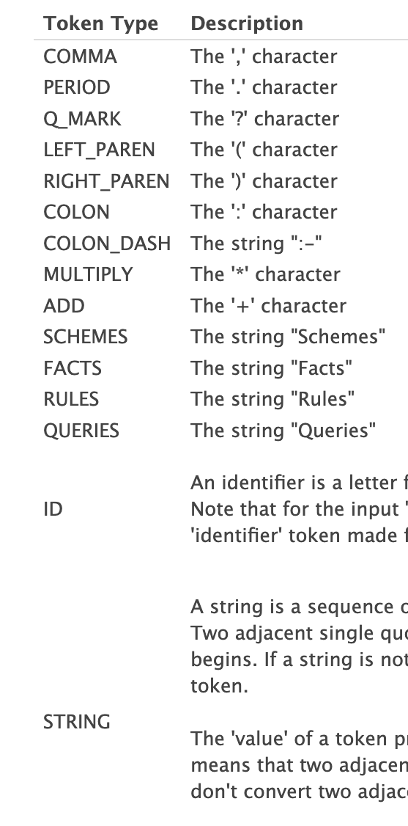
What is Lexing?
Every valid Datalog program follows regular patterns:
Schemes:
f(A,B)
g(C,D)
Facts:
f('1','2').
f('4','3').
g('3','2').
Rules:
Queries:
f('3',Z)?
g(‘3’,Z)?
Lexer
Datalog is a database programming language
Lexing finds the keywords, symbols, and user-defined things

Slide 12
What is Lexing?
Every valid Datalog program follows regular patterns:
Lexing “pulls out” these patterns
Schemes:
f(A,B)
g(C,D)
Facts:
f('1','2').
f('4','3').
g('3','2').
Rules:
Queries:
f('3',Z)?
g(‘3’,Z)?
Lexer
Datalog is a database programming language
Lexing finds the keywords, symbols, and user-defined things

Slide 13
What is Lexing?
(SCHEMES,"Schemes",1)
(COLON,":",1)
(ID,"f",2)
(LEFT_PAREN,"(",2)
(ID,"A",2)
(COMMA,",",2)
(ID,"B",2)
(RIGHT_PAREN,")",2)
(ID,"g",3)
(LEFT_PAREN,"(",3)
(ID,"C",3)
(COMMA,",",3)
(ID,"D",3)
(RIGHT_PAREN,")",3)
(FACTS,"Facts",5)
(COLON,":",5)
(ID,"f",6)
(LEFT_PAREN,"(",6)
(STRING,"'1’”,6)
(COMMA,",",6)
(STRING,"'2’”,6)
(RIGHT_PAREN,")",6)
(PERIOD,".",6)
(ID,"f",7)
(LEFT_PAREN,"(",7)
(STRING,"'4’”,7)
(COMMA,",",7)
(STRING,"'3’”,7)
(RIGHT_PAREN,")",7)
(PERIOD,".",7)
(ID,"g",8)
(LEFT_PAREN,"(",8)
(STRING,"'3’”,8)
Every valid Datalog program follows regular patterns:
Lexing “pulls out” these patterns
Schemes:
f(A,B)
g(C,D)
Facts:
f('1','2').
f('4','3').
g('3','2').
Rules:
Queries:
f('3',Z)?
g(‘3’,Z)?
Lexer

Slide 14
What is Lexing?
(SCHEMES,"Schemes",1)
(COLON,":",1)
(ID,"f",2)
(LEFT_PAREN,"(",2)
(ID,"A",2)
(COMMA,",",2)
(ID,"B",2)
(RIGHT_PAREN,")",2)
(ID,"g",3)
(LEFT_PAREN,"(",3)
(ID,"C",3)
(COMMA,",",3)
(ID,"D",3)
(RIGHT_PAREN,")",3)
(FACTS,"Facts",5)
(COLON,":",5)
(ID,"f",6)
(LEFT_PAREN,"(",6)
(STRING,"'1’”,6)
(COMMA,",",6)
(STRING,"'2’”,6)
(RIGHT_PAREN,")",6)
(PERIOD,".",6)
(ID,"f",7)
(LEFT_PAREN,"(",7)
(STRING,"'4’”,7)
(COMMA,",",7)
(STRING,"'3’”,7)
(RIGHT_PAREN,")",7)
(PERIOD,".",7)
(ID,"g",8)
(LEFT_PAREN,"(",8)
(STRING,"'3’”,8)
Every valid Datalog program follows regular patterns:
Lexing “pulls out” these patterns
Schemes:
f(A,B)
g(C,D)
Facts:
f('1','2').
f('4','3').
g('3','2').
Rules:
Queries:
f('3',Z)?
g(‘3’,Z)?
Lexer

Slide 15
What is Lexing?
(SCHEMES,"Schemes",1)
(COLON,":",1)
(ID,"f",2)
(LEFT_PAREN,"(",2)
(ID,"A",2)
(COMMA,",",2)
(ID,"B",2)
(RIGHT_PAREN,")",2)
(ID,"g",3)
(LEFT_PAREN,"(",3)
(ID,"C",3)
(COMMA,",",3)
(ID,"D",3)
(RIGHT_PAREN,")",3)
(FACTS,"Facts",5)
(COLON,":",5)
(ID,"f",6)
(LEFT_PAREN,"(",6)
(STRING,"'1’”,6)
(COMMA,",",6)
(STRING,"'2’”,6)
(RIGHT_PAREN,")",6)
(PERIOD,".",6)
(ID,"f",7)
(LEFT_PAREN,"(",7)
(STRING,"'4’”,7)
(COMMA,",",7)
(STRING,"'3’”,7)
(RIGHT_PAREN,")",7)
(PERIOD,".",7)
(ID,"g",8)
(LEFT_PAREN,"(",8)
(STRING,"'3’”,8)
Every valid Datalog program follows regular patterns:
Lexing “pulls out” these patterns
Schemes:
f(A,B)
g(C,D)
Facts:
f('1','2').
f('4','3').
g('3','2').
Rules:
Queries:
f('3',Z)?
g(‘3’,Z)?
Lexer

Slide 16
What is Lexing?
(SCHEMES,"Schemes",1)
(COLON,":",1)
(ID,"f",2)
(LEFT_PAREN,"(",2)
(ID,"A",2)
(COMMA,",",2)
(ID,"B",2)
(RIGHT_PAREN,")",2)
(ID,"g",3)
(LEFT_PAREN,"(",3)
(ID,"C",3)
(COMMA,",",3)
(ID,"D",3)
(RIGHT_PAREN,")",3)
(FACTS,"Facts",5)
(COLON,":",5)
(ID,"f",6)
(LEFT_PAREN,"(",6)
(STRING,"'1’”,6)
(COMMA,",",6)
(STRING,"'2’”,6)
(RIGHT_PAREN,")",6)
(PERIOD,".",6)
(ID,"f",7)
(LEFT_PAREN,"(",7)
(STRING,"'4’”,7)
(COMMA,",",7)
(STRING,"'3’”,7)
(RIGHT_PAREN,")",7)
(PERIOD,".",7)
(ID,"g",8)
(LEFT_PAREN,"(",8)
(STRING,"'3’”,8)
Every valid Datalog program follows regular patterns:
Lexing “pulls out” these patterns
Schemes:
f(A,B)
g(C,D)
Facts:
f('1','2').
f('4','3').
g('3','2').
Rules:
Queries:
f('3',Z)?
g(‘3’,Z)?
Lexer

Slide 17
What is Lexing?
(SCHEMES,"Schemes",1)
(COLON,":",1)
(ID,"f",2)
(LEFT_PAREN,"(",2)
(ID,"A",2)
(COMMA,",",2)
(ID,"B",2)
(RIGHT_PAREN,")",2)
(ID,"g",3)
(LEFT_PAREN,"(",3)
(ID,"C",3)
(COMMA,",",3)
(ID,"D",3)
(RIGHT_PAREN,")",3)
(FACTS,"Facts",5)
(COLON,":",5)
(ID,"f",6)
(LEFT_PAREN,"(",6)
(STRING,"'1’”,6)
(COMMA,",",6)
(STRING,"'2’”,6)
(RIGHT_PAREN,")",6)
(PERIOD,".",6)
(ID,"f",7)
(LEFT_PAREN,"(",7)
(STRING,"'4’”,7)
(COMMA,",",7)
(STRING,"'3’”,7)
(RIGHT_PAREN,")",7)
(PERIOD,".",7)
(ID,"g",8)
(LEFT_PAREN,"(",8)
(STRING,"'3’”,8)
Every valid Datalog program follows regular patterns:
Lexing “pulls out” these patterns
Schemes:
f(A,B)
g(C,D)
Facts:
f('1','2').
f('4','3').
g('3','2').
Rules:
Queries:
f('3',Z)?
g(‘3’,Z)?
Lexer
User-defined identifiers have regular patterns.
Look for these regular patterns

Slide 18
What is Lexing?
(SCHEMES,"Schemes",1)
(COLON,":",1)
(ID,”mike0",2)
(LEFT_PAREN,"(",2)
(ID,"A",2)
(COMMA,",",2)
(ID,"B",2)
(RIGHT_PAREN,")",2)
(ID,"g",3)
(LEFT_PAREN,"(",3)
(ID,"C",3)
(COMMA,",",3)
(ID,"D",3)
(RIGHT_PAREN,")",3)
(FACTS,"Facts",5)
(COLON,":",5)
(ID,”mike0",6)
(LEFT_PAREN,"(",6)
(STRING,"'1’”,6)
(COMMA,",",6)
(STRING,"'2’”,6)
(RIGHT_PAREN,")",6)
(PERIOD,".",6)
(ID,”mike0",7)
(LEFT_PAREN,"(",7)
(STRING,"'4’”,7)
(COMMA,",",7)
(STRING,"'3’”,7)
(RIGHT_PAREN,")",7)
(PERIOD,".",7)
(ID,"g",8)
(LEFT_PAREN,"(",8)
(STRING,"'3’”,8)
Every valid Datalog program follows regular patterns:
Lexing “pulls out” these patterns
Schemes:
mike0(A,B)
g(C,D)
Facts:
mike0('1','2').
mike0('4','3').
g('3','2').
Rules:
Queries:
mike0('3',Z)?
g(‘3’,Z)?
Lexer
User-defined identifiers have regular patterns.
Look for these regular patterns

Slide 19
(SCHEMES,"Schemes",1)
(COLON,":",1)
(ID,"f",2)
(LEFT_PAREN,"(",2)
(ID,"A",2)
(COMMA,",",2)
(ID,"B",2)
(RIGHT_PAREN,")",2)
(ID,"g",3)
(LEFT_PAREN,"(",3)
(ID,"C",3)
(COMMA,",",3)
(ID,"D",3)
(RIGHT_PAREN,")",3)
(FACTS,"Facts",5)
(COLON,":",5)
(ID,"f",6)
(LEFT_PAREN,"(",6)
(STRING,"'1’”,6)
(COMMA,",",6)
(STRING,"'2’”,6)
(RIGHT_PAREN,")",6)
(PERIOD,".",6)
(ID,"f",7)
(LEFT_PAREN,"(",7)
(STRING,"'4’”,7)
(COMMA,",",7)
(STRING,"'3’”,7)
(RIGHT_PAREN,")",7)
(PERIOD,".",7)
(ID,"g",8)
(LEFT_PAREN,"(",8)
(STRING,"'3’”,8)
(SCHEMES,"Schemes",1)
(COLON,":",1)
(ID,”mike0",2)
(LEFT_PAREN,"(",2)
(ID,"A",2)
(COMMA,",",2)
(ID,"B",2)
(RIGHT_PAREN,")",2)
(ID,"g",3)
(LEFT_PAREN,"(",3)
(ID,"C",3)
(COMMA,",",3)
(ID,"D",3)
(RIGHT_PAREN,")",3)
(FACTS,"Facts",5)
(COLON,":",5)
(ID,”mike0",6)
(LEFT_PAREN,"(",6)
(STRING,"'1’”,6)
(COMMA,",",6)
(STRING,"'2’”,6)
(RIGHT_PAREN,")",6)
(PERIOD,".",6)
(ID,”mike0",7)
(LEFT_PAREN,"(",7)
(STRING,"'4’”,7)
(COMMA,",",7)
(STRING,"'3’”,7)
(RIGHT_PAREN,")",7)
(PERIOD,".",7)
(ID,"g",8)
(LEFT_PAREN,"(",8)
(STRING,"'3’”,8)
After lexing, two programs that are identical
except for comments, identifier names, and
what’s in strings show identical patterns.

Slide 20
(SCHEMES,"Schemes",1)
(COLON,":",1)
(ID,"f",2)
(LEFT_PAREN,"(",2)
(ID,"A",2)
(COMMA,",",2)
(ID,"B",2)
(RIGHT_PAREN,")",2)
(ID,"g",3)
(LEFT_PAREN,"(",3)
(ID,"C",3)
(COMMA,",",3)
(ID,"D",3)
(RIGHT_PAREN,")",3)
(FACTS,"Facts",5)
(COLON,":",5)
(ID,"f",6)
(LEFT_PAREN,"(",6)
(STRING,"'1’”,6)
(COMMA,",",6)
(STRING,"'2’”,6)
(RIGHT_PAREN,")",6)
(PERIOD,".",6)
(ID,"f",7)
(LEFT_PAREN,"(",7)
(STRING,"'4’”,7)
(COMMA,",",7)
(STRING,"'3’”,7)
(RIGHT_PAREN,")",7)
(PERIOD,".",7)
(ID,"g",8)
(LEFT_PAREN,"(",8)
(STRING,"'3’”,8)
(SCHEMES,"Schemes",1)
(COLON,":",1)
(ID,”mike0",2)
(LEFT_PAREN,"(",2)
(ID,"A",2)
(COMMA,",",2)
(ID,"B",2)
(RIGHT_PAREN,")",2)
(ID,"g",3)
(LEFT_PAREN,"(",3)
(ID,"C",3)
(COMMA,",",3)
(ID,"D",3)
(RIGHT_PAREN,")",3)
(FACTS,"Facts",5)
(COLON,":",5)
(ID,”mike0",6)
(LEFT_PAREN,"(",6)
(STRING,"'1’”,6)
(COMMA,",",6)
(STRING,"'2’”,6)
(RIGHT_PAREN,")",6)
(PERIOD,".",6)
(ID,”mike0",7)
(LEFT_PAREN,"(",7)
(STRING,"'4’”,7)
(COMMA,",",7)
(STRING,"'3’”,7)
(RIGHT_PAREN,")",7)
(PERIOD,".",7)
(ID,"g",8)
(LEFT_PAREN,"(",8)
(STRING,"'3’”,8)
After lexing, two programs that are identical
except for comments, identifier names, and
what’s in strings show identical patterns.
We need a tool to extract these patterns!

Slide 21
Finite State Machines
a cousin of regular expressions

Slide 22
Regular Expressions
Schemes:
mike0(A,B)
g(C,D)
Facts:
mike0('1','2').
mike0('4','3').
g('3','2').
Rules:
Queries:
mike0('3',Z)?
g(‘3’,Z)?
Each keyword, symbol, identifier, and string
follows a pattern that can be described using
a regular expression.

Slide 23
Regular Expressions
Schemes:
mike0(A,B)
g(C,D)
Facts:
mike0('1','2').
mike0('4','3').
g('3','2').
Rules:
Queries:
mike0('3',Z)?
g(‘3’,Z)?
Each keyword, symbol, identifier, and string
follows a pattern that can be described using
a regular expression.

Slide 24
Regular Expressions
Schemes:
mike0(A,B)
g(C,D)
Facts:
mike0('1','2').
mike0('4','3').
g('3','2').
Rules:
Queries:
mike0('3',Z)?
g(‘3’,Z)?
Each keyword, symbol, identifier, and string
follows a pattern that can be described using
a regular expression.
Infinite number of legal identifiers. That’s bad

Slide 25
Two pattern manager tools
Regular Expressions
Pattern
Regular Expression
All strings matching
that pattern

Slide 26
Two pattern manager tools
Regular Expressions
Finite State Automata
Pattern
Pattern
Regular Expression
Finite State Automata
Specific
string
All strings matching
that pattern
Does that specific
string match that pattern

Slide 27
Two pattern manager tools
Identifier
pattern
Finite State Automata
Pattern
Finite State Automata
Finite State Automata
Specific
string
mike2
yes
Does that specific
string match that pattern

Slide 28
Two pattern manager tools
Identifier
pattern
Finite State Automata
Pattern
Finite State Automata
Finite State Automata
Specific
string
2mike
no
Does that specific
string match that pattern

Slide 29
Finite State Machines and Finite State Automata
One outputs anything we want anytime we want
One just says “yes” or “no”

Slide 30
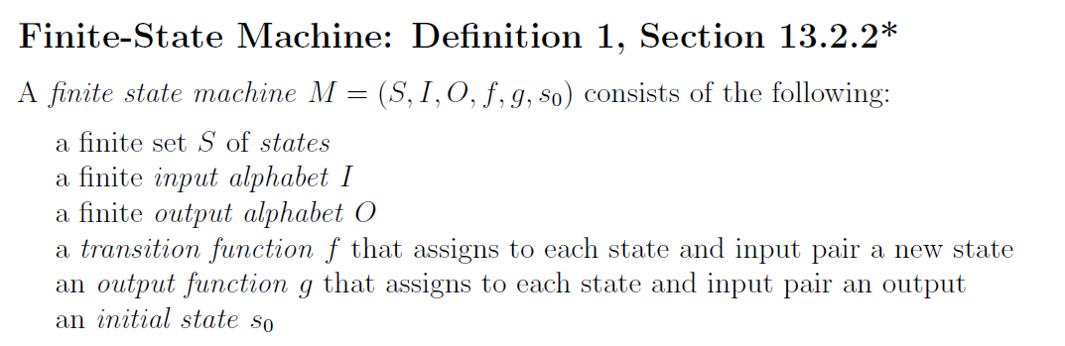
Definition

Slide 31
COVID Model
S
E
I
R
S = susceptible
E = exposed (but not infectious)
I = infectious
R = removed

Slide 32
COVID Model
I⁺
S
E
R
I⁻
S = susceptible
E = exposed (but not infectious)
I⁺ = infectious and symptomatic
I⁻ = infectious and asymptomatic
R = removed

Slide 33
Definition
S
E
I
R

Slide 34
Definition
S
E
I
R

Slide 35
Definition
S
E
I
R

Slide 36
Definition
S
E
I
R

Slide 37
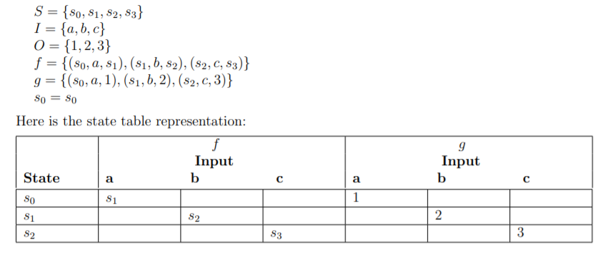
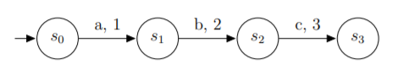
Finite-State Machines: Def 1 §13.2.2
Represented in state diagram or table

Slide 38
Finite-State Machines: Def 1 §13.2.2
Represented in state diagram or table
using the notation about functions
from last class period

Slide 39
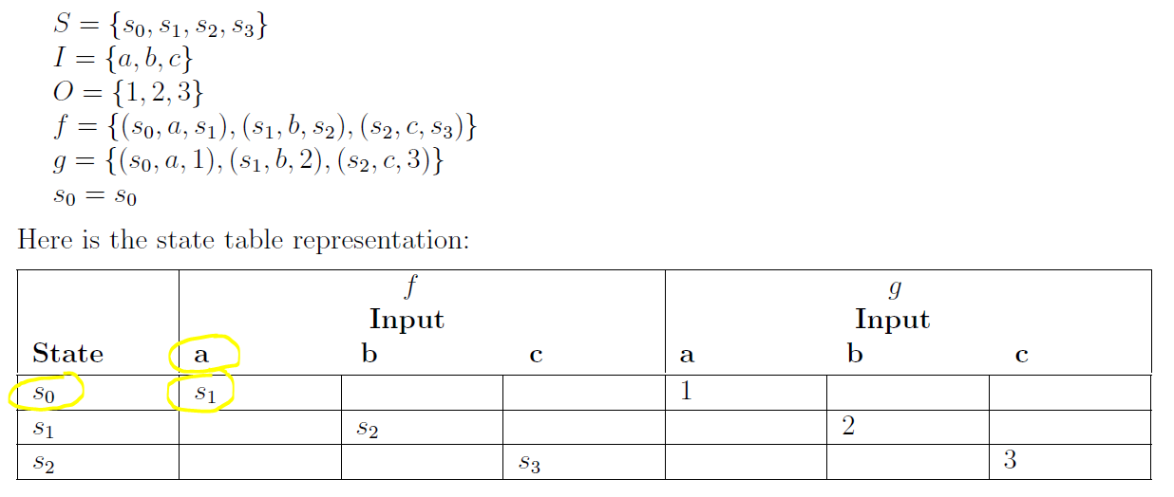
Finite-State Machines - Input
Represented in state diagram or table
Review Definition 1, Section 13.2.2
current state

Slide 40
Finite-State Machines - Input
Represented in state diagram or table
Review Definition 1, Section 13.2.2
input

Slide 41
Finite-State Machines - Input
Represented in state diagram or table
Review Definition 1, Section 13.2.2
next state

Slide 42
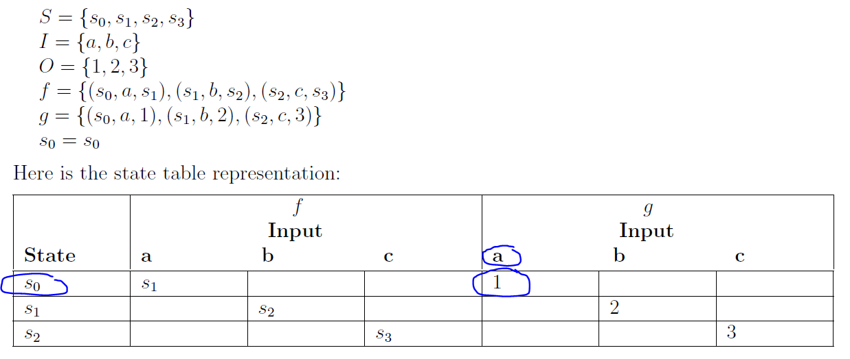
Finite-State Machines - Output
Represented in state diagram or table
Review Definition 1, Section 13.2.2
current state

Slide 43
Finite-State Machines - Output
Represented in state diagram or table
Review Definition 1, Section 13.2.2
current state

Slide 44
Finite-State Machines - Output
Represented in state diagram or table
Review Definition 1, Section 13.2.2
input

Slide 45
Finite-State Machines - Output
Represented in state diagram or table
Review Definition 1, Section 13.2.2
output

Slide 46


Example – Honeybees looking for a nest
Notes:
Gist of behavior

Slide 47
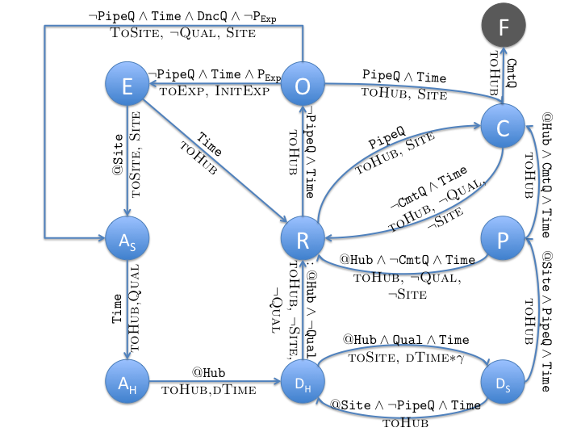
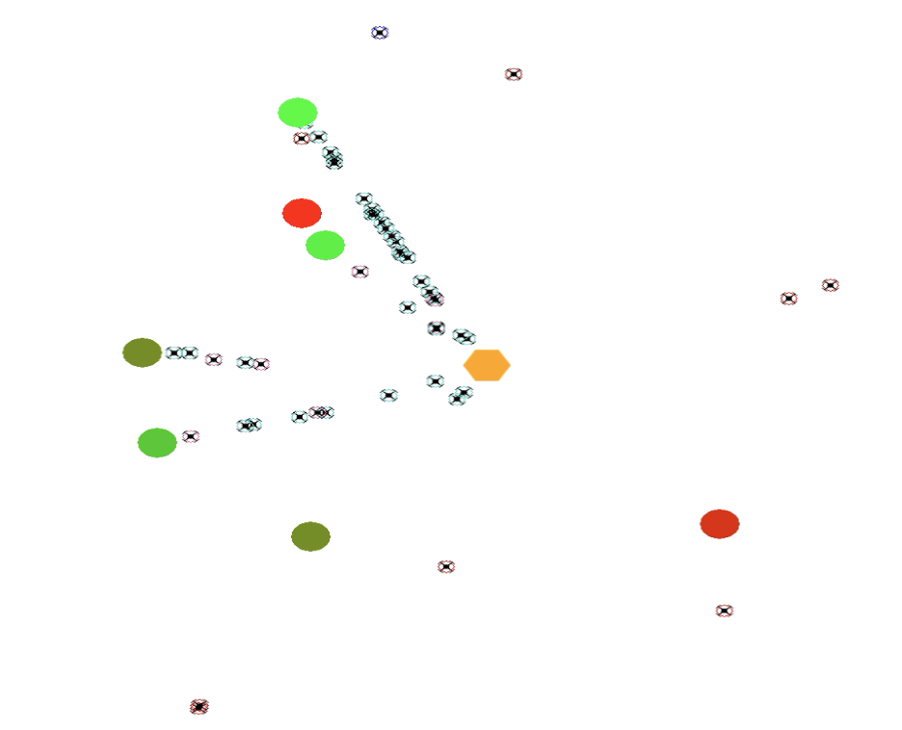
Example – Honeybees looking for a nest
Rest
Observe
Explore
Assess
Dance
Pipe
Commit
Notes:
Actual model used in the video.
The words above the transition is input that determines the transition, like timing out and resting after exploring for a long time
The small caps words under the transition describes what behaviors the honeybees will perform, like go to the hub and remember the site.

Slide 48
FSM Exercise
Create a finite-state machine that outputs “Marco” every time it reads a 1 and “Polo” every time it reads a 0
I = {0,1}
O = {Marco, Polo}

Slide 49
FSM Exercise
I = {0, 1}
Create a finite-state machine that outputs “Marco” every time it reads a 1 and “Polo” every time it reads a 0
I = {0, 1}
0 , “Polo”
s₀
1 , “Marco”

Slide 50
FSM Exercise
I = {0, 1}
The two FSMs are equivalent because they give the exact same output for all inputs
0 , “Polo”
0 , “Polo”
0 , “Polo”
s₀
s₀
s₁
1 , “Marco”
1 , “Marco”
1 , “Marco”

Slide 51
Applying FSMs to Lexing

Slide 52
What is a Lexer?
The lexer is a collection of state machines,
each tuned to look for a particular pattern.
When a machine finds the pattern, it outputs
the pattern name, which we call a token
Datalog program
Lexer
Parser
Execution
tokens
“meaning”
Stream from program one char at a time.
Output sequence (vector) of tokens.

Slide 53
What is a Lexer?
A lexer is a program that turns programmer-specific “items” into programmer-independent structures called “tokens”
Each token contains the information the computer needs:
a token name, which is selected from a set of predefined names, e.g. “STRING”
the specific “item” for that token, e.g. "Hello World“
a line number
A token encodes the text into the corresponding symbols of the programming language of the file
The output of the lexer is an ordered collection of tokens

Slide 54
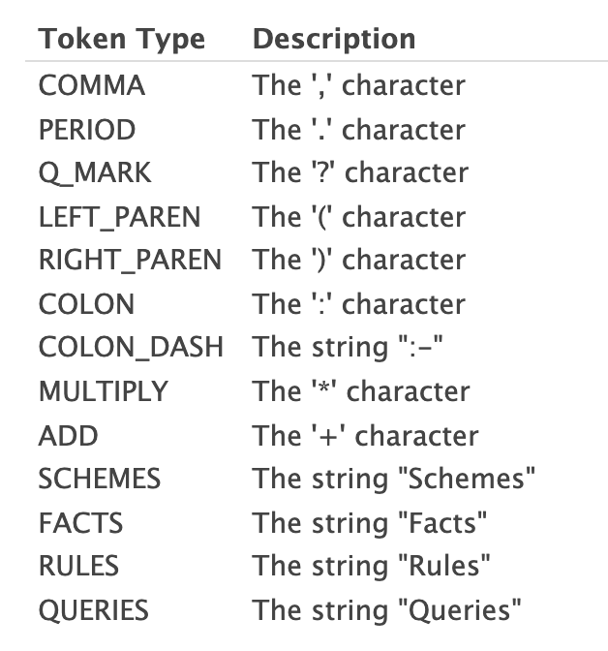
Using FSMs to lex Datalog
Datalog code
Rules:
marriedTo(X,Y) :- marriedTo(Y,X).

Slide 55
What is a Lexer?
The lexer is a collection of state machines,
each tuned to look for a particular pattern.
When a machine finds the pattern, it outputs
the pattern name, which we call a token
Datalog program
Lexer
Parser
Execution
tokens
“meaning”
Stream from program one char at a time.
Output sequence (vector) of tokens.

Slide 56
What is a Lexer?
A lexer is a program that turns programmer-specific “items” into programmer-independent structures called “tokens”
Each token contains the information the computer needs:
a token name, which is selected from a set of predefined names, e.g. “STRING”
the specific “item” for that token, e.g. "Hello World“
a line number
A token encodes the text into the corresponding symbols of the programming language of the file
The output of the lexer is an ordered collection of tokens

Slide 57
Using FSMs to lex Datalog
Datalog code
Rules:
marriedTo(X,Y) :- marriedTo(Y,X).

Slide 58
Using FSMs to lex Datalog
Datalog code
Rules:
marriedTo(X,Y) :- marriedTo(Y,X).
Create a state machine that outputs “LEFT_PAREN” if the
input sequence is “(” and otherwise outputs “BOO”

Slide 59
Project 1: FSM for “Rules” Datalog keyword
s₀
R , λ
not R , fail
s₁
not u , fail
u , λ
s₂
not l , fail
s_{fail}
l , λ
not e , fail
s₃
not s , fail
e , λ
s₄
s , RULES
s₅

Slide 60
Project 1: FSM for “Rules” Datalog keyword
s₀
R , λ
not R , fail
s₁
not u , fail
u , λ
s₂
not l , fail
s_{fail}
l , λ
not e , fail
s₃
not s , fail
e , λ
s₄
Functions, not partial functions Use an error state
You have to specify a state transition for every input from every state
You have to specify an output for every input from every state
s , RULES
s₅

Slide 61
Running a Finite State Machine
Traces

Slide 62
A Slight Twist on the Automaton
Finite State Automata
Pattern
Finite State Automaton
Specific
string
Does that specific
string match that pattern

Slide 63
A Slight Twist on the Automaton
Finite State Automata
Pattern
Finite State Automaton
Specific
string
Does that specific
string match that pattern

Slide 64
A Slight Twist on the Automata
Finite State Machine
Pattern
Finite State Machine
Specific
string
Does that specific
string match that pattern

Slide 65
A Slight Twist on the Automata
Finite State Machine
Pattern
Finite State Machine
Specific
string
Does that specific
string match that pattern

Slide 66
A Slight Twist on the Automata
Finite State Machine
Pattern
Finite State Machine
Specific
string
Output the
pattern name

Slide 67
Project 1: FSM for “Rules” Datalog keyword
s₀
Let’s do a trace on two different inputs
R , λ
not R , fail
s₁
not u , fail
u , λ
s₂
not l , fail
s_{fail}
l , λ
not e , fail
s₃
not s , fail
e , λ
s₄
s , RULES
s₅

Slide 68
Project 1: FSM for “Rules” Datalog keyword
s₀
Let’s do a trace on two different inputs
R , λ
not R , fail
Input string
Output
s₁
Rules
not u , fail
u , λ
s₂
not l , fail
s_{fail}
l , λ
not e , fail
s₃
not s , fail
e , λ
s₄
s , RULES
s₅

Slide 69
Project 1: FSM for “Rules” Datalog keyword
s₀
Let’s do a trace on two different inputs
R , λ
not R , fail
Input string
Output
s₁
Rules
not u , fail
u , λ
s₂
not l , fail
s_{fail}
l , λ
not e , fail
s₃
not s , fail
e , λ
s₄
s , RULES
s₅

Slide 70
Project 1: FSM for “Rules” Datalog keyword
s₀
Let’s do a trace on two different inputs
R , λ
not R , fail
Input string
Output
s₁
Rules
not u , fail
u , λ
s₂
not l , fail
s_{fail}
l , λ
not e , fail
s₃
not s , fail
e , λ
s₄
s , RULES
s₅

Slide 71
Project 1: FSM for “Rules” Datalog keyword
s₀
Let’s do a trace on two different inputs
R , λ
not R , fail
Input string
Output
s₁
Rules
not u , fail
u , λ
s₂
not l , fail
s_{fail}
l , λ
not e , fail
s₃
not s , fail
e , λ
s₄
s , RULES
s₅

Slide 72
Project 1: FSM for “Rules” Datalog keyword
s₀
Let’s do a trace on two different inputs
R , λ
not R , fail
Input string
Output
s₁
Rules
not u , fail
u , λ
s₂
not l , fail
s_{fail}
l , λ
not e , fail
s₃
not s , fail
e , λ
s₄
s , RULES
s₅

Slide 73
Project 1: FSM for “Rules” Datalog keyword
s₀
Let’s do a trace on two different inputs
R , λ
not R , fail
Input string
Output
s₁
Rules
λ
not u , fail
u , λ
s₂
not l , fail
s_{fail}
l , λ
not e , fail
s₃
not s , fail
e , λ
s₄
s , RULES
s₅

Slide 74
Project 1: FSM for “Rules” Datalog keyword
s₀
Let’s do a trace on two different inputs
R , λ
not R , fail
Input string
Output
s₁
Rules
λ
not u , fail
u , λ
s₂
not l , fail
s_{fail}
l , λ
not e , fail
s₃
not s , fail
e , λ
s₄
s , RULES
s₅

Slide 75
Project 1: FSM for “Rules” Datalog keyword
s₀
Let’s do a trace on two different inputs
R , λ
not R , fail
Input string
Output
s₁
Rules
λ
not u , fail
u , λ
s₂
not l , fail
s_{fail}
l , λ
not e , fail
s₃
not s , fail
e , λ
s₄
s , RULES
s₅

Slide 76
Project 1: FSM for “Rules” Datalog keyword
s₀
Let’s do a trace on two different inputs
R , λ
not R , fail
Input string
Output
s₁
Rules
λ
not u , fail
u , λ
s₂
not l , fail
s_{fail}
l , λ
not e , fail
s₃
not s , fail
e , λ
s₄
s , RULES
s₅

Slide 77
Project 1: FSM for “Rules” Datalog keyword
s₀
Let’s do a trace on two different inputs
R , λ
not R , fail
Input string
Output
s₁
Rules
λ
not u , fail
u , λ
s₂
not l , fail
s_{fail}
l , λ
not e , fail
s₃
not s , fail
e , λ
s₄
s , RULES
s₅

Slide 78
Project 1: FSM for “Rules” Datalog keyword
s₀
Let’s do a trace on two different inputs
R , λ
not R , fail
Input string
Output
s₁
Rules
RULES
not u , fail
u , λ
s₂
not l , fail
s_{fail}
l , λ
not e , fail
s₃
not s , fail
e , λ
s₄
s , RULES
s₅

Slide 79
Another input

Slide 80
Project 1: FSM for “Rules” Datalog keyword
s₀
Let’s do a trace on two different inputs
R , λ
not R , fail
Input string
Output
s₁
Rust
λ
not u , fail
u , λ
s₂
not l , fail
s_{fail}
l , λ
not e , fail
s₃
not s , fail
e , λ
s₄
s , RULES
s₅

Slide 81
Project 1: FSM for “Rules” Datalog keyword
s₀
Let’s do a trace on two different inputs
R , λ
not R , fail
Input string
Output
s₁
Rust
λ
not u , fail
u , λ
s₂
not l , fail
s_{fail}
l , λ
not e , fail
s₃
not s , fail
e , λ
s₄
s , RULES
s₅

Slide 82
Project 1: FSM for “Rules” Datalog keyword
s₀
Let’s do a trace on two different inputs
R , λ
not R , fail
Input string
Output
s₁
Rust
fail
not u , fail
u , λ
s₂
not l , fail
s_{fail}
l , λ
not e , fail
s₃
not s , fail
e , λ
s₄
s , RULES
s₅

Slide 83
Finite State Automaton
A cousin of a finite state machine

Slide 84
Formal definition (def 3 in §13.3.3)
A finite state automaton (FSA) is a tuple (S, I, s_{o}, F, f)
Finite set of states: S
Set of input characters: I
Start state: s_{o}
Set of final or accept states: F
Transition function: f: S ⨉ I ⟶ S

Slide 85
Formal definition (def 3 in §13.3.3)
A finite state automaton (FSA) is a tuple (S, I, s_{o}, F, f)
Finite set of states: S
Set of input characters: I
Start state: s_{o}
Set of final or accept states: F
Transition function: f: S ⨉ I ⟶ S

Slide 86
Formal definition (def 3 in §13.3.3)
A finite state automaton (FSA) is a tuple (S, I, s_{o}, F, f)
Finite set of states: S
Set of input characters: I
Start state: s_{o}
Set of final or accept states: F
Transition function: f: S ⨉ I ⟶ S
What’s the same?

Slide 87
Formal definition (def 3 in §13.3.3)
A finite state automaton (FSA) is a tuple (S, I, s_{o}, F, f)
Finite set of states: S
Set of input characters: I
Start state: s_{o}
Set of final or accept states: F
Transition function: f: S ⨉ I ⟶ S
What’s different?

Slide 88
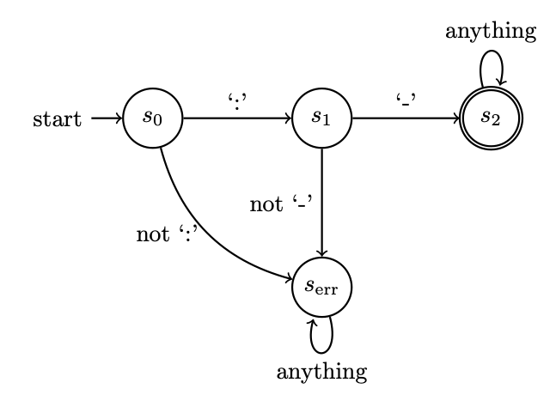
Example FSA
Tuple (S, I, s_{o}, F, f)
Finite set of states: S
Set of input characters: I
Start state: s_{o}
Set of final or accept states: F
Transition function: f: S ⨉ I ⟶ S

Slide 89
Practice

Slide 90
Design a finite state machine that outputs “COLON-DASH” only if the input string is “:-”
Design a finite state automaton that succeeds only if the input string is “:-”
Pattern
Pattern
Finite State Machine
Finite State Automaton
Specific
string
Specific
string
Output the
pattern name
Does that specific
string match that pattern

Slide 91
Design a finite state machine that outputs “COLON-DASH” only if the input string is “:-”
Design a finite state automaton that succeeds only if the input string is “:-”

Slide 92
Design a finite state machine that outputs “COLON-DASH” only if the input string is “:-”
Design a finite state automaton that succeeds only if the input string is “:-”
-, COLON-DASH
s₀
: , λ
s₂
s₁
not : , fail
not - , fail
s_{fail}

Slide 93
Design a finite state machine that outputs “COLON-DASH” only if the input string is “:-”
Design a finite state automaton that succeeds only if the input string is “:-”
-, COLON-DASH
s₀
: , λ
s₂
s₁
not : , fail
not - , fail
s_{fail}

Slide 94
Design a finite state machine that outputs “COLON-DASH” only if the input string is “:-”
Design a finite state automaton that succeeds only if the input string is “:-”
-, COLON-DASH
s₀
: , λ
s₂
s₁
not : , fail
not - , fail
s_{fail}

Slide 95
Example FSA
Tuple (S, I, s_{o}, F, f)
Finite set of states: S
Set of input characters: I
Start state: s_{o}
Set of final or accept states: F
Transition function: f: S ⨉ I ⟶ S
A double circle represents an accept state

